Slide 1
18CSC311: MACHINE LEARNING Lecture 2
References: Towards data science, Machine Learning Mastery, Textbooks as per the syllabus

Slide 2
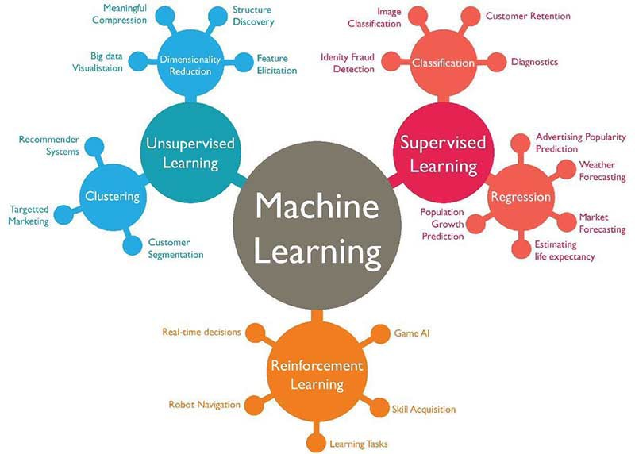
Types of ML Algorithms
Supervised Learning/Predictive Learning
Unsupervised Learning/ Descriptive Learning
Semi-Supervised Learning
Reinforcement Learning

Slide 3
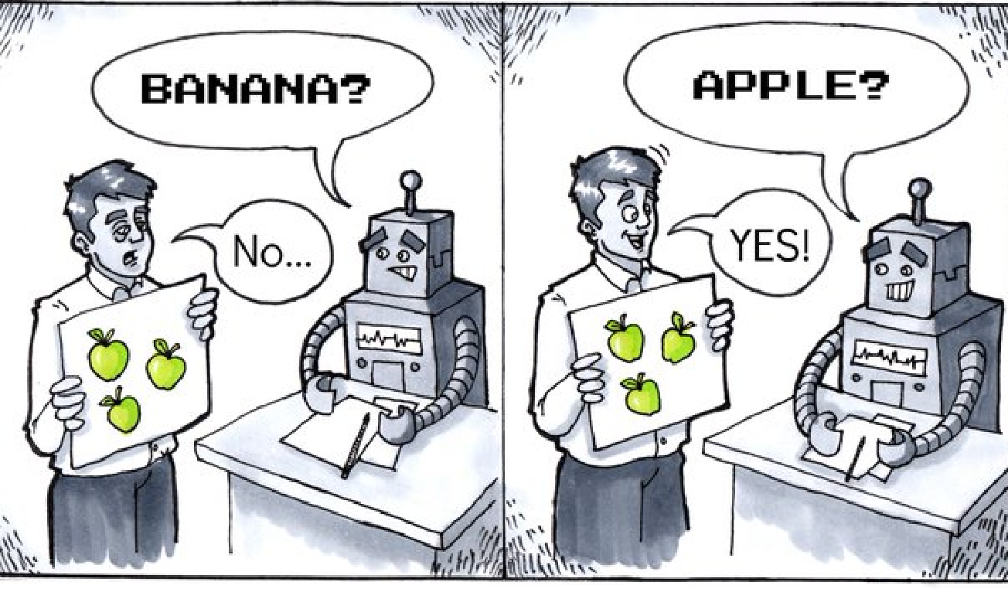
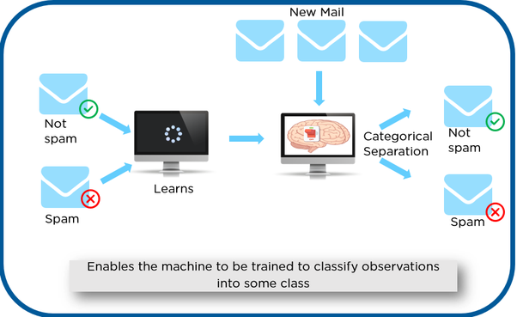
Supervised Learning
The machine has a "supervisor" or a "teacher" who gives the machine all the answers, like whether it's a apple in the picture or a orange.
The teacher has already divided (labeled) the data into oranges and apples, and the machine is using these examples to learn -- > One by one

Slide 4
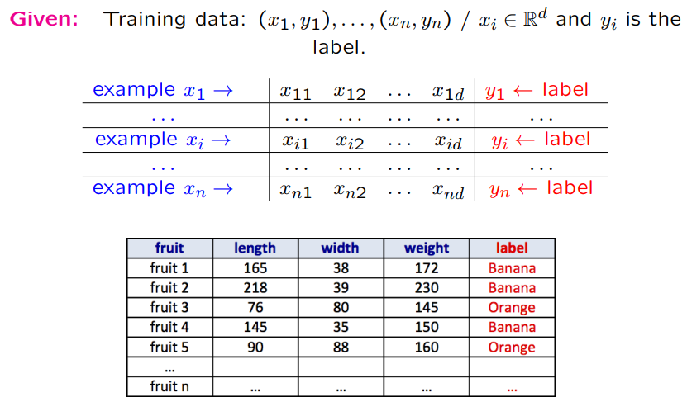
Supervised Learning

Slide 5
Supervised Learning
When an algorithm learns from example data and associated target responses in order to later predict the correct response when posed with new examples
Labeled data: Data consisting of a set of training examples, where each example is a pair consisting of an input and a desired output value (also called the supervisory signal, labels, etc)

Slide 6

Supervised Learning
Classification: Attempts to find the appropriate class label, such as analyzing positive/negative sentiment, male and female persons, benign and malignant tumors, secure and unsecure loans etc.
Regression: Predicts a continuous-valued response, for example predicting real estate prices.
Map input variables into discrete categories
Map input variables to some continuous function

Slide 7
Supervised Learning
House Rent Prediction
SQ.FEET | RENT
100 | 1500
200 | 3000
500 | 5000
800 | 6000
1200 | 12500
2000 | 18000
700 | ?
Regression

Slide 8
Supervised Learning
Given a picture of Male/Female, predict his/her age on the basis of given picture.
Given a picture of Male/Female, predict Whether He/She is of High school, College, Graduate age.
Banks have to decide whether or not to give a loan to someone on the basis of his credit history
Regression
Classification
Classification

Slide 9
Supervised Learning
Predicting the results of a game.
Predicting whether a tumour is malignant or benign.
Predicting the price of domains like real estates, stokes etc.
Classifying an email as spam or not.
Face recognition
Regression
Classification
Regression
Classification
Classifcation

Slide 10
Solve this…
You’re running a company, and you want to develop learning algorithms to address each of two problems.
Problem 1:You have a large inventory of identical items. You want to predict how many of these items will sell over the next 3 months.
Problem 2: You’d like software to examine individual customer accounts, and for each account decide if it has been hacked/compromised. Should you treat these as classification or as regression problems?
Treat both as classification problems.
Treat problem 1 as a classification problem, problem 2 as a regression problem.
Treat problem 1 as a regression problem, problem 2 as a classification problem.
Treat both as regression problems.

Slide 11
Supervised Learning -Algorithms
k-Nearest Neighbours
Decision Trees
Naive Bayes
Logistic Regression
Linear Regression
Support Vector Machines

Slide 12
Unsupervised Learning

Slide 13
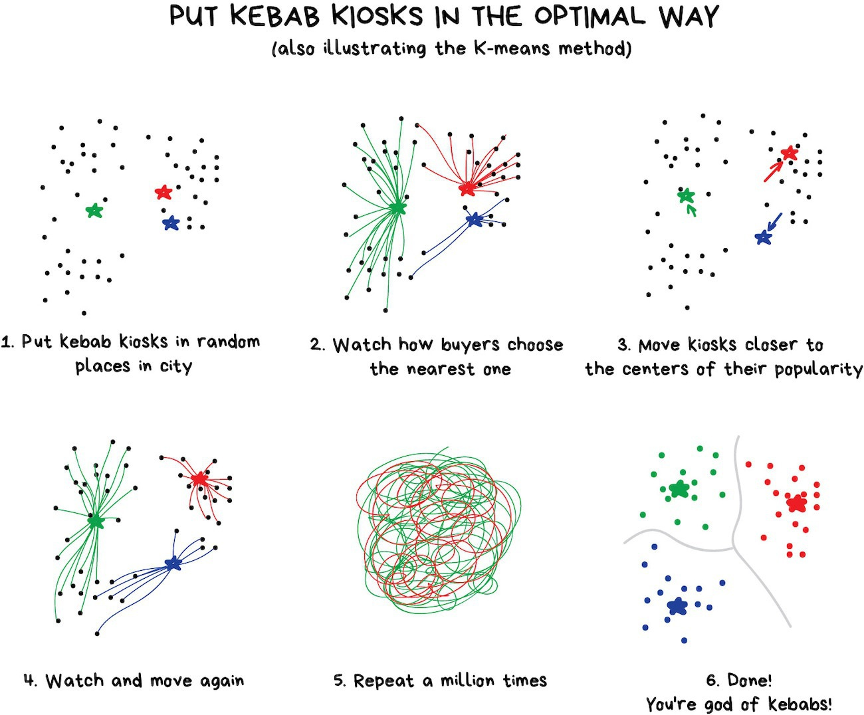
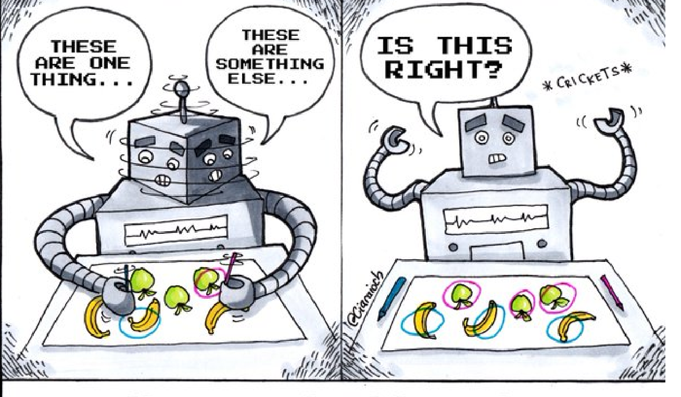
Unsupervised learning- Clustering
Divides objects based on unknown features. Machine chooses the best way

Slide 14
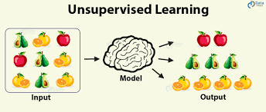
Unsupervised Learning
Learn from the data- No labels
Discover interesting structures from the data- Knowledge Discovery
Does not require an human expert to label the data
In unsupervised learning, there is no instructor or teacher, and the algorithm must learn to make sense of the data without this guide.
— Page 105, Deep Learning, 2016.

Slide 15
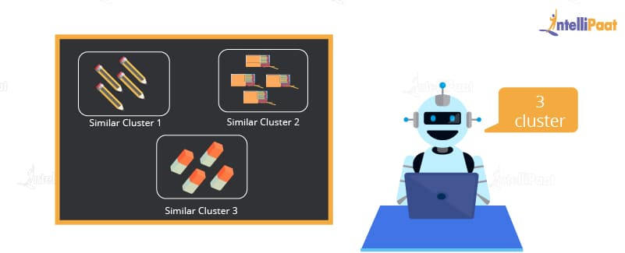
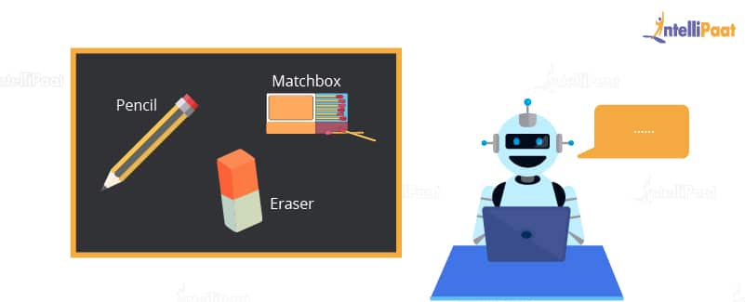
Unsupervised Learning
Clustering
Detecting potentially useful clusters of input examples.
For example, a taxi agent might gradually develop a concept of “good traffic days” and “bad traffic days” without ever being given labeled examples of each by a teacher.
— Pages 694-695, Artificial Intelligence: A Modern Approach, 3rd edition, 2015.

Slide 16
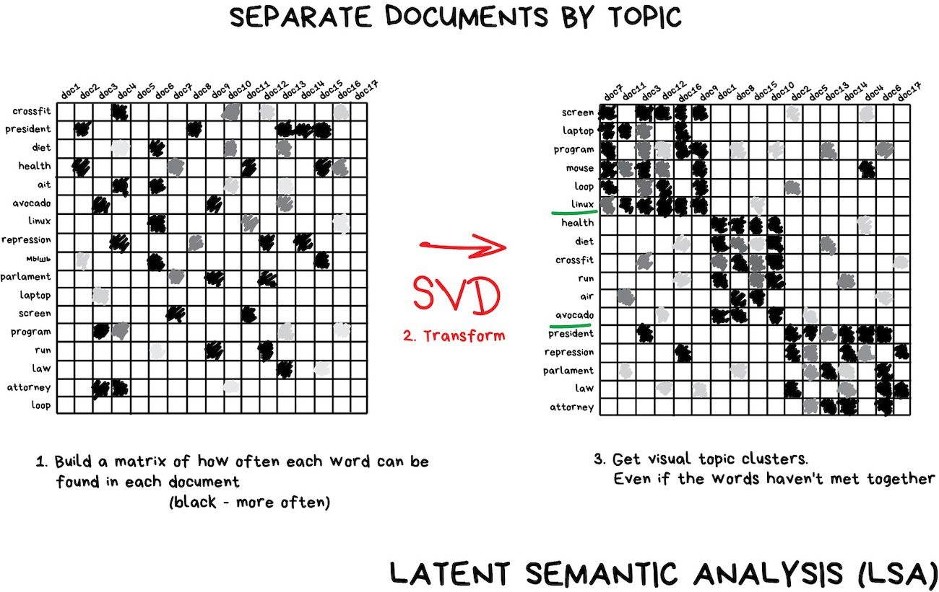
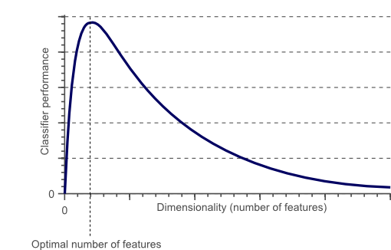
Unsupervised learning - Dimensionality Reduction
Assembles specific features into more high-level ones

Slide 17
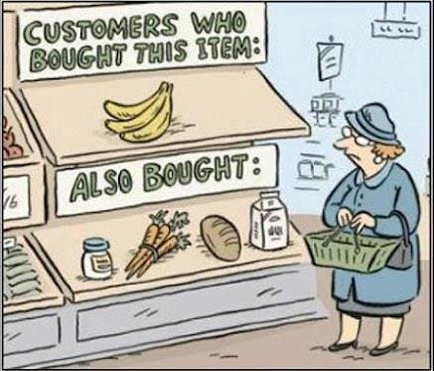
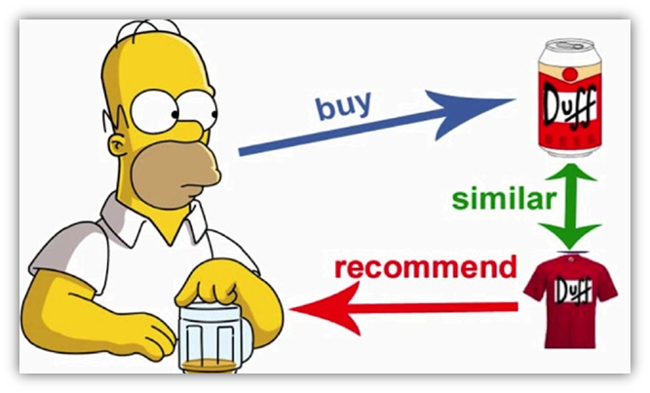
Unsupervised learning - Association rule learning
"Look for patterns in the orders' stream"

Slide 18
Solve this…
Of the following examples, which would you address using an unsupervised learning algorithm? (Check all that apply.)
Given email labeled as spam/not spam, learn a spam filter.
Given a set of news articles found on the web, group them into sets of articles about the same stories.
Given a database of customer data, automatically discover market segments and group customers into different market segments.
Given a dataset of patients diagnosed as either having diabetes or not, learn to classify new patients as having diabetes or not.

Slide 19
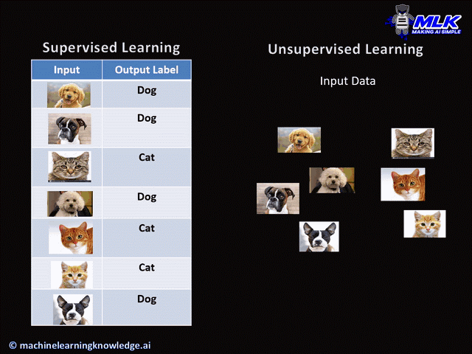

Supervised VS Unsupervised
Supervised | Unsupervised
Labelled data | No labels
Direct Feedback | No feed back
Predict outcome | Find Hidden Structure in data
Supervised machine learning helps you to solve various types of real-world computation problems. | It is easier to get unlabeled data from a computer than labeled data, which needs manual intervention.

Slide 20
Semi-supervised Learning
If some learning samples are labeled, but some other are not labeled, then it is semi-supervised learning.
It makes use of a large amount of unlabeled data for training and a small amount of labeled data for testing.
Trained upon a combination of labeled and unlabeled data
First, cluster similar data using an unsupervised learning algorithm
Then use the existing labeled data to label the rest of the unlabeled data
Semi-supervised learning is applied in cases where it is expensive to acquire a fully labeled dataset while more practical to label a small subset.

Slide 21
Semi-supervised Learning

Slide 22
Reinforcement Learning
Accompany an example with positive or negative feedback according to the
solution the algorithm proposes
Learning by trial and error: The system evaluates its performance based on the feedback responses and reacts accordingly
“how to act or behave when given occasional reward or punishment signals”

Slide 23
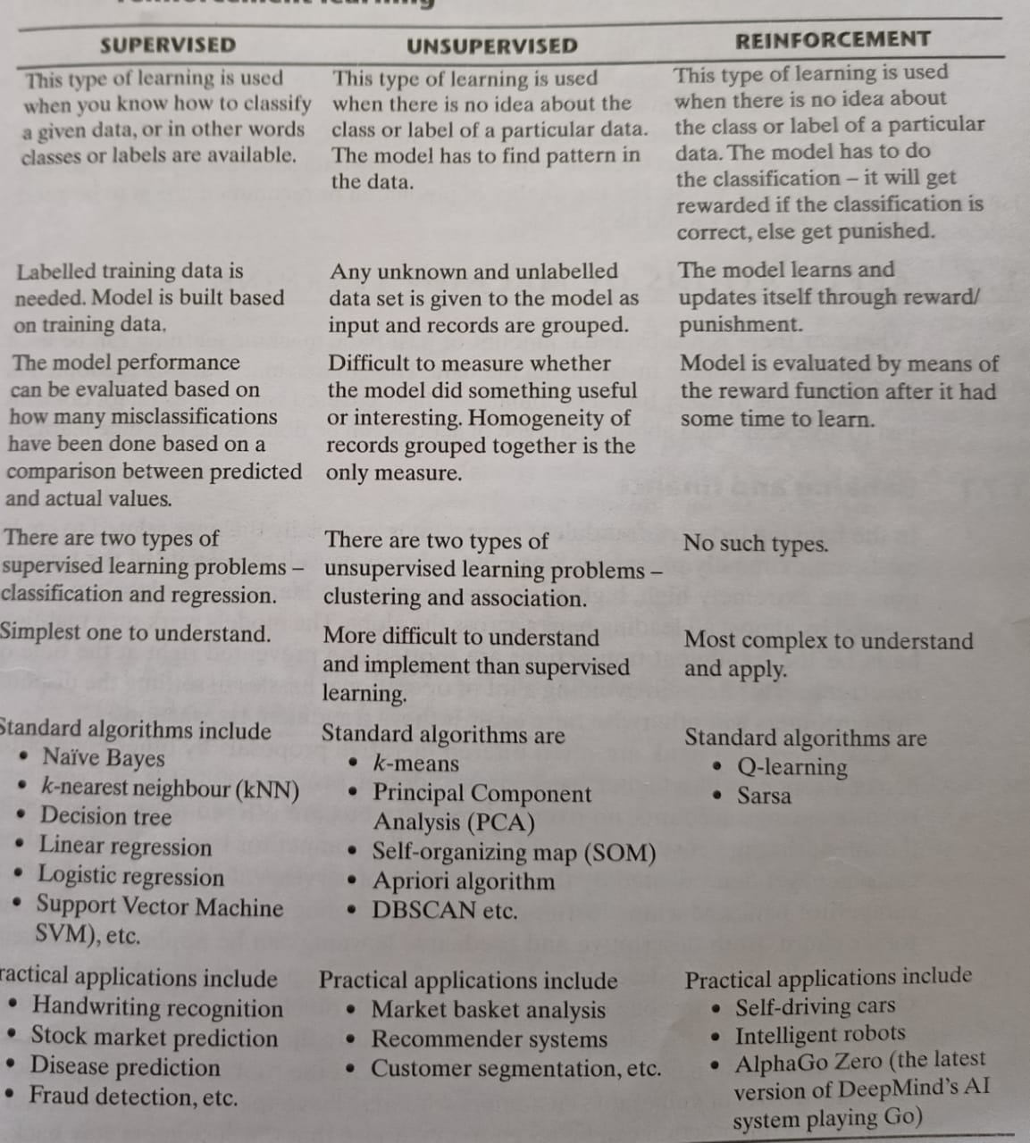

Slide 24
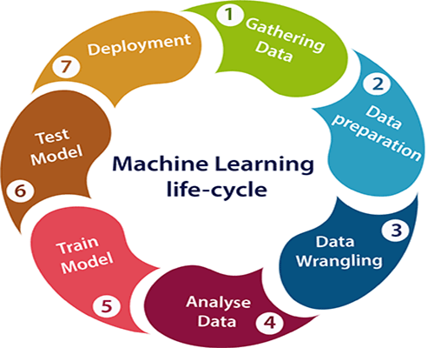

7 Steps Of Machine Learning
Problem: Classification of Oranges and Apples.

Slide 25
Step – 1 Gathering Data
First real step of machine learning is gathering data
Quality and quantity of data
Color | Shape | Apple or Orange?
Red | Round Conical | Apple
Orange | Round | Orange
Data Collection
For collecting data on color, we may use a spectrometer and, for the shape data, we may use pictures of the fruits so that they can be treated as 2D figures.
For the purpose of collecting data, we would try to get as many different types of apples and orange as possible in order to create diverse data sets for our features. For this purpose, we may try to search the markets for oranges and apples that may be from different parts of the world.

Slide 26
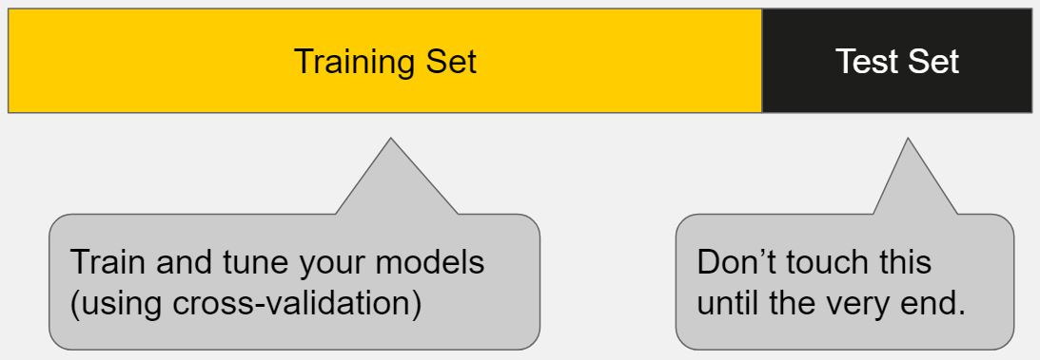
Step – 2 Data preparation
Load our data into a suitable place and prepare it for use in our machine learning training
Randomize the ordering – will improve the model
Visualizations of your data - Relevant relationships vs Data imbalances
Example
More data points about apple than orange, the model we train will be biased
Split the data in two parts.
First used in training our model, will be the majority of the dataset – Train data
Second part will be used for evaluating our trained model’s performance – Test Data
Not to use the same data for training and testing

Slide 27
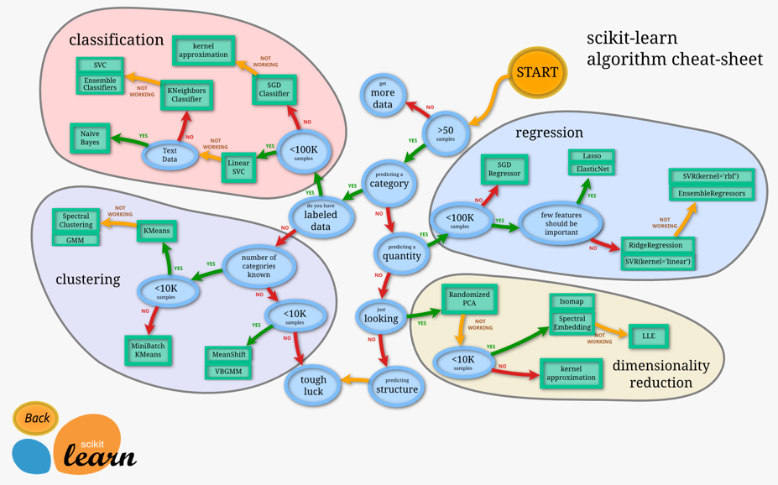
Step – 3 Choosing a model
Categorize the problem
Categorize by input
Categorize by output
Understand your constraints
Find the available algorithms

Slide 28
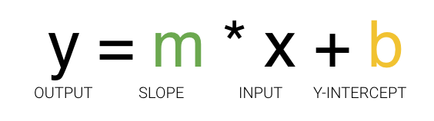
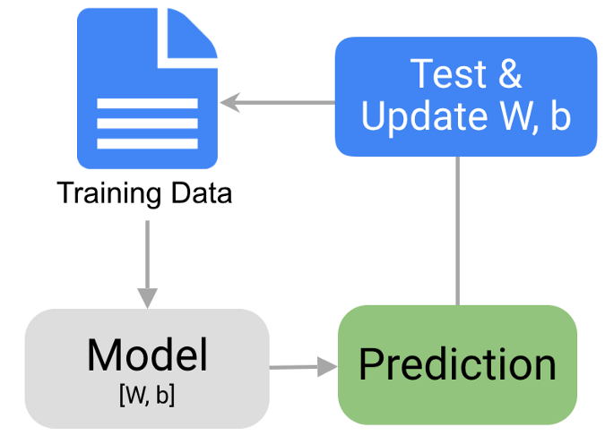
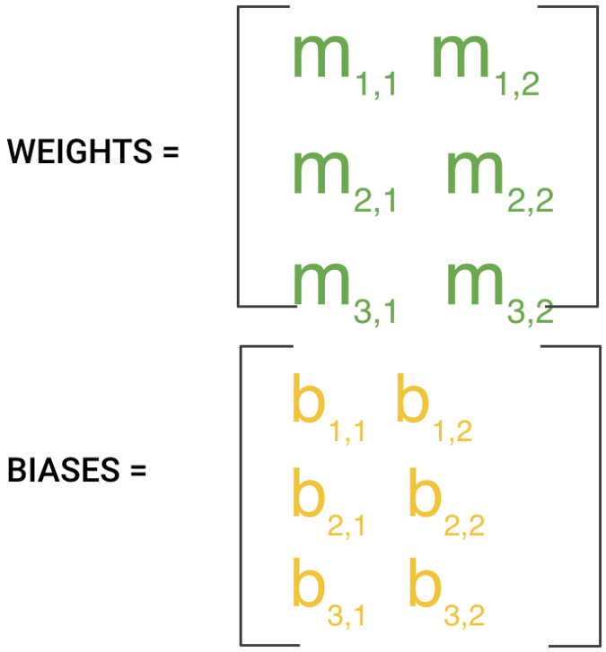
Step – 4 Training
Use our data to incrementally improve our model’s ability
Weights
Biases
Each iteration or cycle of updating the weights and biases is called one training “step”

Slide 29
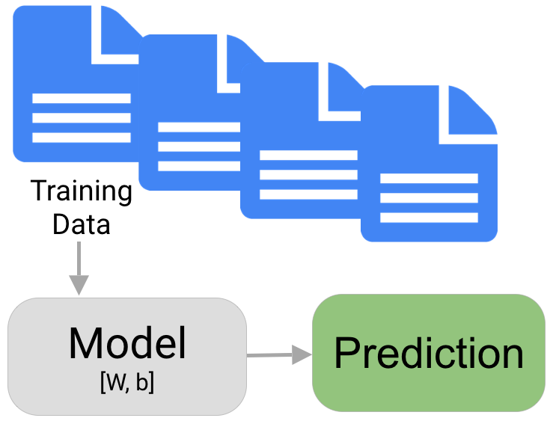
Step – 5 and 6
Step 6 : Parameter Tuning
Further improvement to training
Many times we run through the training dataset
Step 5: Evaluation
Classification Accuracy
Logarithmic Loss
Confusion Matrix
Area under Curve
F1 Score
Mean Absolute Error
Mean Squared Error

Slide 30
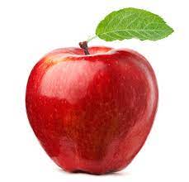
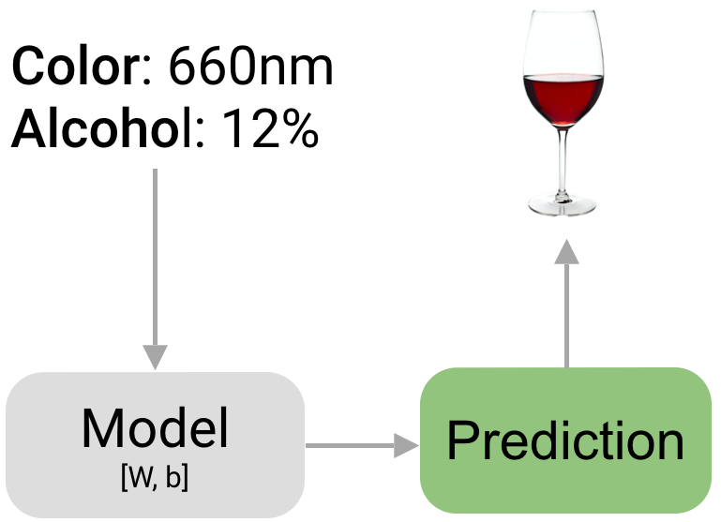
Step – 7 Prediction / Inference
Color: Red
Shape: Round and Conical

Slide 31
ML-Terminologies

Slide 32
ML Terminologies
Algorithm
A method, function, or series of instructions used to generate a machine learning model. Examples include linear regression, decision trees, support vector machines, and neural networks.
Attribute
A quality describing an observation (e.g. color, size, weight). In Excel terms, these are column headers.
Dimension
How much feature you have in you data .

Slide 33
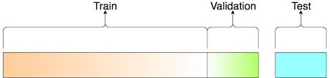
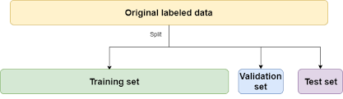
ML Terminologies
Training set
A set of observations used to generate machine learning models.
Test set
A set of observations used at the end of model training and validation to assess the predictive power of your model. How generalizable is your model to unseen data?
Validation set
A set of observations used during model training to provide feedback on how well the current parameters generalize beyond the training set. If training error decreases but validation error increases, your model is likely overfitting and you should pause training.

Slide 34
ML Terminologies
Dataset Split
First split the dataset into 2 — Train and Test
Keep aside the Test set
Randomly choose X% of their Train dataset to be the actual Train set and the remaining (100-X)% to be the Validation set
The model is then iteratively trained and validated on these different sets

Slide 35

ML Terminologies
Dataset Split
Cross Validation: K Fold
The training set is split into k smaller sets
The following procedure is followed for each of the k “folds”:
A model is trained using K-1 of the folds as training data;
The resulting model is validated on the remaining part of the data (i.e., it is used as a test set to compute a performance measure such as accuracy).

Slide 36
ML Terminologies
Parameters
Parameters are properties of training data learned by training a machine learning model or classifier. They are adjusted using optimization algorithms and unique to each experiment.
Examples of parameters include:
weights in an artificial neural network
support vectors in a support vector machine
coefficients in a linear or logistic regression

Slide 37
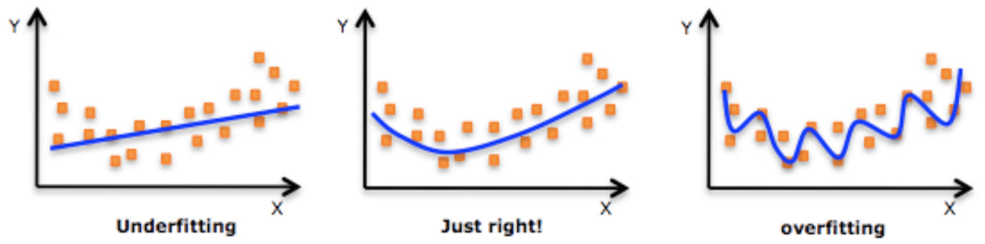
ML Terminologies
Overfitting
Overfitting occurs when your model learns the training data too well and incorporates details and noise specific to your dataset. You can tell a model is overfitting when it performs great on your training/validation set, but poorly on your test set (or new real-world data).
Underfitting
The counterpart of overfitting, happens when a machine learning model is not complex enough to accurately capture relationships between a dataset features and target variables.

Slide 38
ML Terminologies
Bias
Bias is the difference between the average prediction of our model and the correct value which we are trying to predict. Model with high bias pays very little attention to the training data and oversimplifies the model. It always leads to high error on training and test data.
Variance
Variance is the variability of model prediction for a given data point or a value which tells us spread of our data. Model with high variance pays a lot of attention to training data and does not generalize on the data which it hasn’t seen before. As a result, such models perform very well on training data but has high error rates on test data..

Slide 39
THANK YOU

